Slide 1
Organized Access to Historical Data
Tam Phan Minh
a1697735

Slide 2
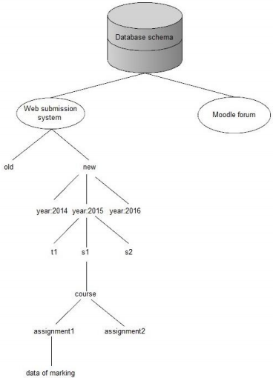
Background
Two separate systems with two databases
One user might create events in both systems
=> Difficult to keep track of students’ events

Slide 3
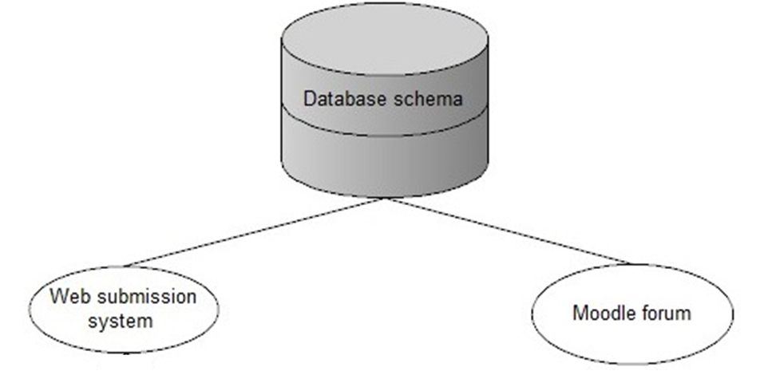
Motivation
Answer critical questions
Who have the marks of MSE course more than 70?
Who made the earliest submission of the assignment 1 of Advanced Algorithm course?
Do students hand in the first assignment on time or late?

Slide 4
Motivation
Why is answering critical questions important?
To systematically withdraw student behavior patterns.
Identify students who are at the risk of failing a course.
Know the frequency and time distribution of students' accesses to courses or resources
The goal => improve teaching practice and identify better ways to evaluate student work.

Slide 5
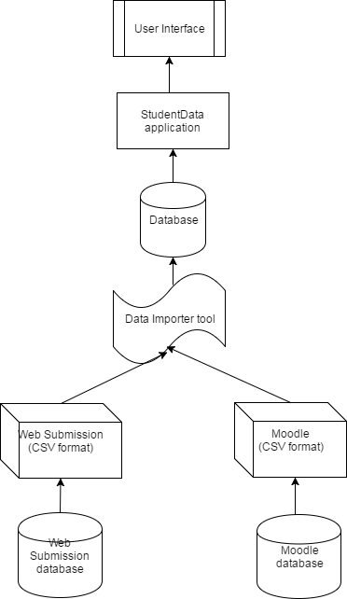
System Overview

Slide 6
StudentData Application Architecture
Three-tier architecture
Presentation layer: PHP, Jasper Reports
Business Logic layer: Web services(JAX-WS)
Data Access layer: Hibernate
Database: MySQL

Slide 7
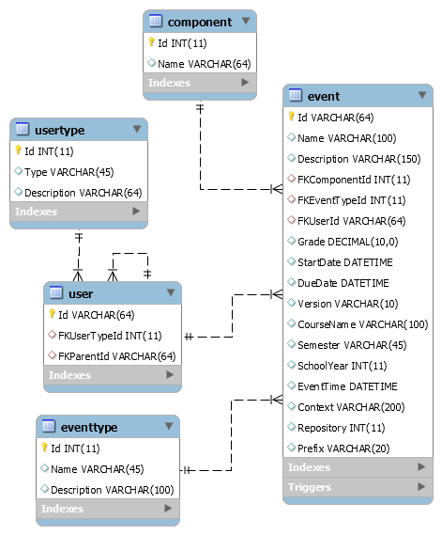
Database design
Generate database script: StudentData_DatabaseCreate.sql
Generate data script: StudentData_GenerateData.sql

Slide 8
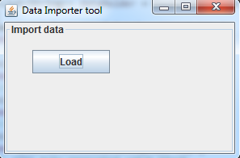
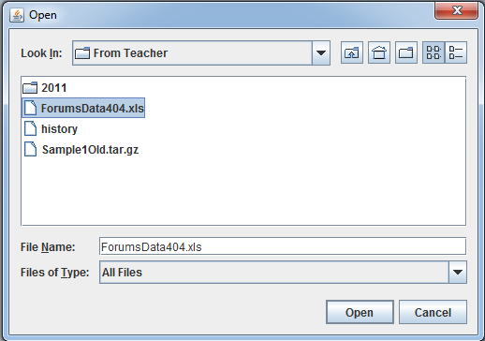
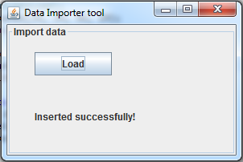
Data importer tool

Slide 9
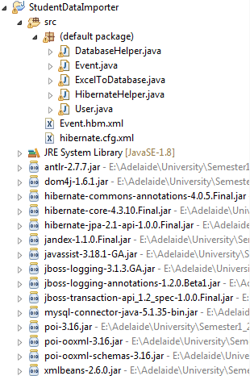
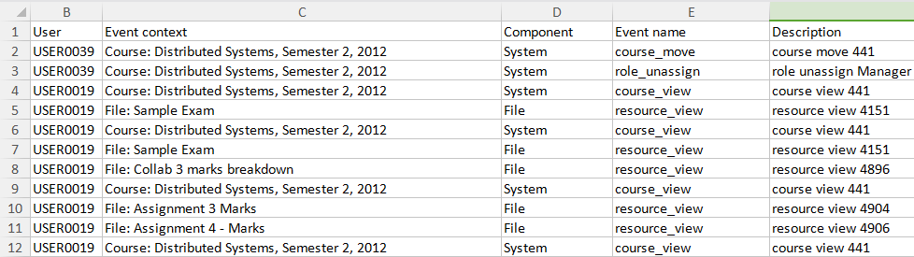
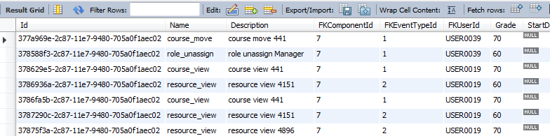
Data importer tool

Slide 10
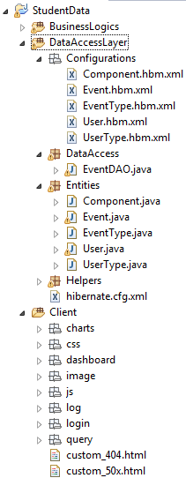
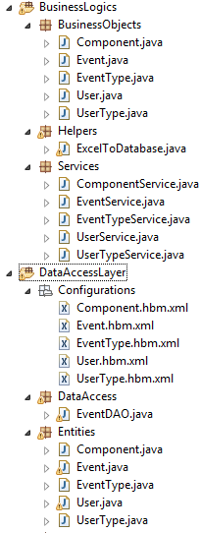
Application source code structure

Slide 11
Future works
Improve the schema to be able to work with large data
Restructure the framework => use Laravel PHP framework.
Replace SOAP by Restful APIs web services
Apply unit test for web services.

Slide 12
Thank you!
References
Drawio - https://www.draw.io/
MySQL - https://www.mysql.com/
JAX-WS - http://docs.oracle.com/javaee/6/tutorial/doc/gijti.html

